Slide 1

Retail Reporting Guide

Slide 2
Login Credentials
Retail pounds MUST be reported by the 1st of the following month.
Agency Account Login Credentials
Agency Reg:
Username:
Password:
Retail Donation Coordinator Contact
Carissa Bailey
  cbailey@foodbankiowa.org
  515-957-2899
Ryan Garvey
  rgarvey@foodbankiowa.org
  515-867-2890

Slide 3
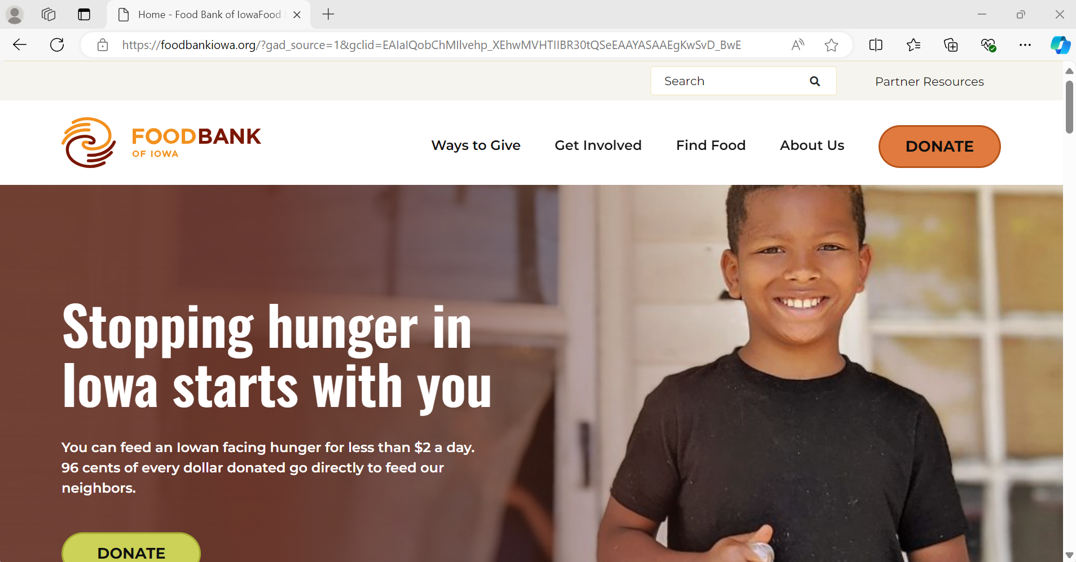
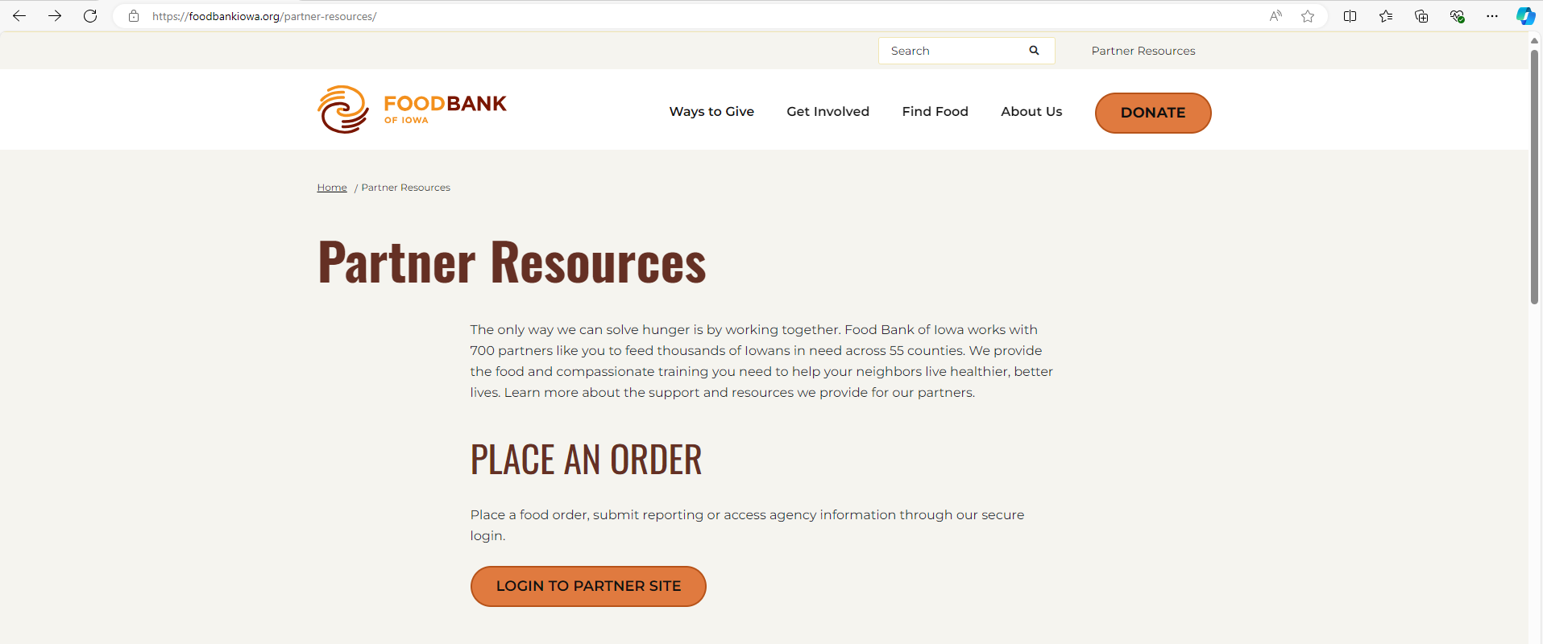
Partner Resources Login
1st
Go to www.foodbankiowa.org
  1st Click on “Partner Resources”
  2nd Click on “Login to Partner Site”
2nd

Slide 4
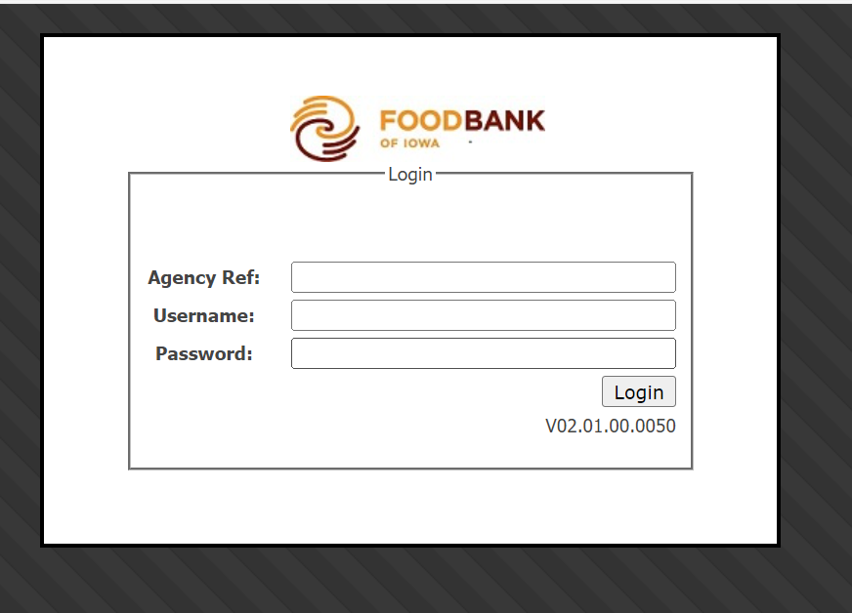
Login Landing Page
Agency Ref and Username are the same number and must be entered with a zero at the beginning.
  Example
    Agency number:
    Enter as:
If you forget your login, please contact Carissa, Ryan, or your regional partnership coordinator.

Slide 5
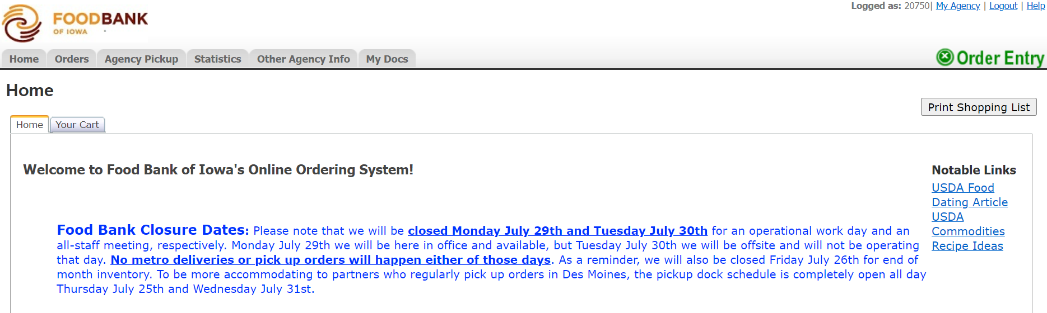
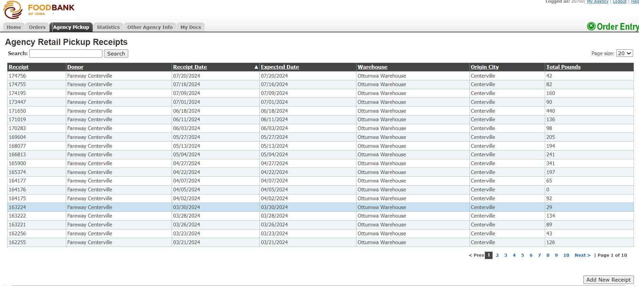
Reporting
Retail pounds MUST be reported by the 1st of the following month.
1st Click on “Agency Pickup”
2nd Click on “Add New Receipt” located bottom right corner.
1st
2nd

Slide 6
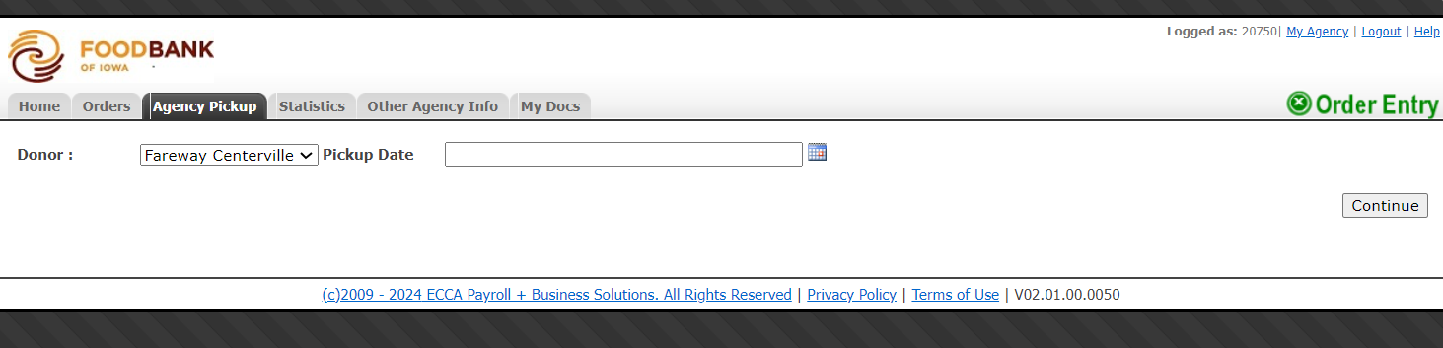
Selecting Donor
1st Click on “drop down arrow” to select correct donor.
2nd Click on “calendar” to select date of pickup.
3rd After selecting the donor and date, click on “continue”.
1st
2nd
3rd

Slide 7
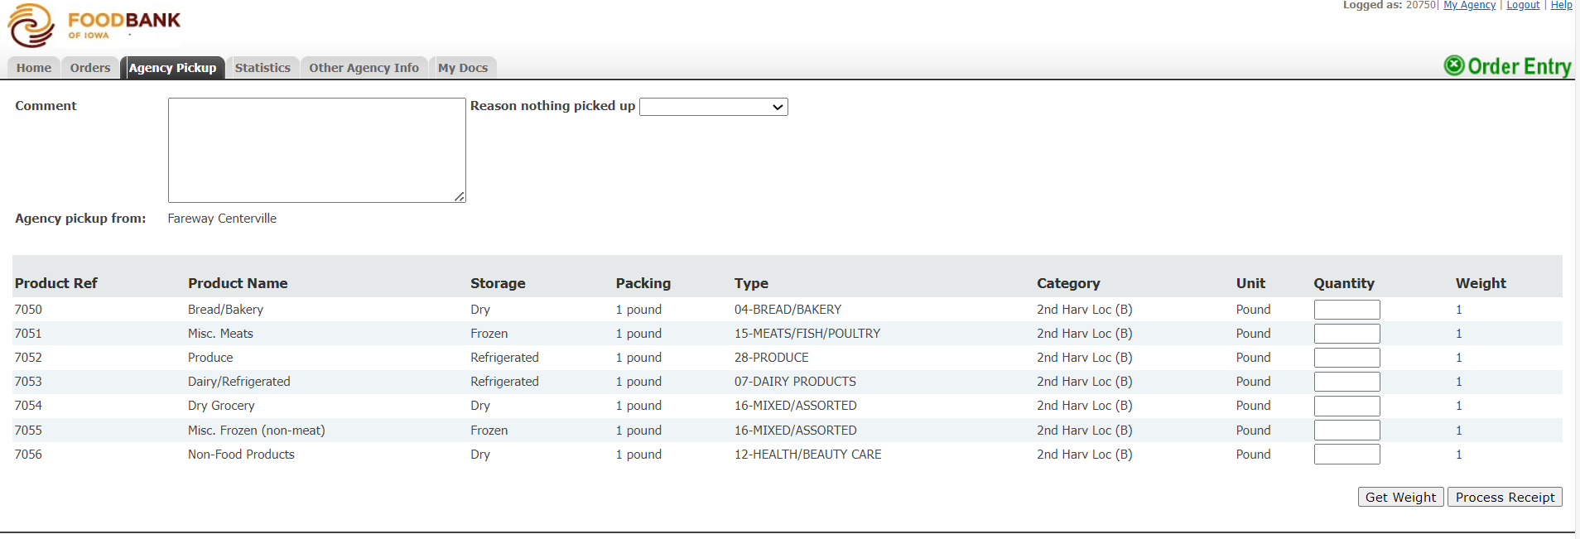
Entering Pounds
1st Enter pounds in the quantity column as whole numbers in the corresponding product category.
2nd Click “Process Receipt”.
  You do not have to enter zero if no product was picked up in every category.
All Done!
1st
2nd

Slide 8
Notes
FBOI
Please submit all reporting by the 1st of the following month.
Please have at least one direct contact number for food rescue. This makes it easier for us to help donors quickly and efficiently when they call for additional pickups or missed pickups.
If you make an error, please email Cassadey or Carissa with receipt number and agency number for corrections.
Donor
Please contact the retailer if you are going to be late or miss a pickup.
If your agency is closed for extended periods of time, please inform the donor and FBOI. We can work together to create a plan for another agency to pickup in your place.
Please give the donor two contact names and phone numbers.

